Slide 1
Special Pathology of Protozoal Diseases
Dr. P.O Okumu
triechomoK

Slide 2
Classification of important pathogenic protozoa
Kingdom: Protista
Subkingdom: Protozoa
Phylum; Sarcomastigophora
Subphylum; Mastigophora
Family; Trypanosomatidae
Genus : Leishmania
Trypanosoma
Family; Hexamitidae
Genus; Giardia
Family; Trichomonadidae
Genus; Tritrichomonas
Trichomonas
Family : Monocercomonadidae
Genus; Histomonas
Subphylum; Sarcodina
Family; Entamoebidae
Genus; Entamoeba

Slide 3
Classification of important pathogenic protozoa
Phylum; Apicomplexa (previously Sporozoa)
Family; Klossiellidae
Genus; Klossiella
Family: Haemogregarinidae
Genus: Hepatozoon
Family; Eimeriidae
Genus; Eimeria
Caryospora
Isospora

Slide 4
Classification of important pathogenic protozoa
Phylum; Apicomplexa (previously Sporozoa)
Family; Cryptosporidiidae
Genus; Cryptosporidium
Family; Sarcocystidae
Genus; Besnoitia
Neospora
Toxoplasma
Sarcocystis
Family ; Plasmodiidae
Genus; Plasmodium

Slide 5
Classification of important pathogenic protozoa
Phylum; Apicomplexa (previously Sporozoa)
Family ; Babesiidae
Genus ; Babesia
Family ; Theileriidae
Genus ; Theileria
Cytauxzoon

Slide 6
Classification of important pathogenic protozoa
Phylum; Microspora
Family; Pleistophoridae
Genus; Encephalitozoon
Phylum; Ciliophora
Family; Balantidiidae
Genus; Balantidium

Slide 7
Genus Eimeria & isospora
1. Coccidiosis
Coccidiosis is the name given to t he disease produced by protozoa of genera Eimeria and Isospora
common in cattle, sheep, and poultry, and is a disease of great economic importance
Review the life cycle of Eimeria

Slide 8
Genus Eimeria & isospora
Important Eimeria & isospora of animals
1. Cattle- Small intestine, caecum,colon
Eimeria bovis- E. zuernii E. ellipsoidalis
2. Sheep- Intestine
E.ovina E. ovinoidalis E.parva
3. Goats- Intestine
E. arloingi E. caprovina E·faurei
4. Pigs-Intestine
E.porci. E. scabra & Isospora suis
5. Dogs- Intestine
Isospora canis, I. burrowsi I. neorivolta
6. Cats- Intestine
Isospora rivolta I.felis
7. Horses & donkeys -Intestines
E. leuckarti s
8. Rabbits- Bile ducts & intestines
E. stiedae E. perforans Intestine

Slide 9
Life cycle of coccidia
Infection occurs by direct invasion of the intestinal epithelium
When oocysts are ingested and reach the small intestine, the trypsin-kinase of the pancreatic juice digests the seal of the micropyle, and through this opening the tiny sporozoites, now actively motile, escape from the oocyst.
Each sporozoite enters a single epithelial cell, where it undergoes asexual development known as schizogony
The sporozoite gradually increases in size, becomes first a trophozoite and finally a schizont.
The schizont completely fills the cytoplasm of the epithelial cell, displacing the nucleus to one side

Slide 10
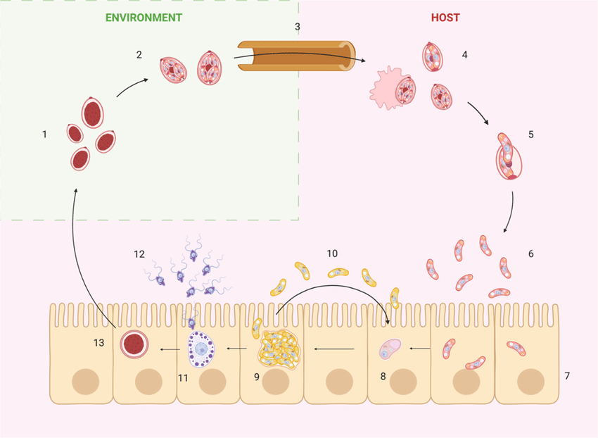
Schematic representation of coccidian life cycle. Numbers indicate the developmental stages of Eimeria spp. and the host structures involved: (1) unsporulated oocysts; (2) sporulated oocysts; (3) gastrointestinal tract; (4) mechanical rupture of oocysts and sporocyst release; (5) excystation of sporozoites; (6) released sporozoites; (7) enterocytes; (8) trophozoite; (9) mature schizont; (10) merozoites and re-infection of enterocytes; (11) macrogamete; (12) microgamete; (13) zygote

Slide 11
Life cycle of coccidia
Each mature schizont contains many elongated structures (spores), which are similar morphologically to sporozoites, but are known as merozoites.
The schizont then ruptures its own wall and also that of the epithelial cell's, liberating the merozoites
The merozoites infect other epithelial cells and continue this asexual life cycle.
some of the merozoites enter into the sexual phase of the cycle, known as gametogenesis or gametogony.
Each of these merozoites develops within an individual epithelial cell into a female form, a macrogamete, or into a male counterpart, a microgametocyte
The microgametocyte finally ruptures to release a large number of tiny motile microgametes
One of the microgametes unites with a single macrogametes
Once thus fertilized, the macrogamete soon becomes an oocyst. These oocysts become infective only after undergoing sporulation
Further development within the oocyst, known as sporogony, requires oxygen and certain other conditions. These are met outside the body of the host.
in rabbits, Eimeria stiedae multiplies in the intrahepatic bile ducts. The sporozoites reach these ducts through portal veins or lymphatics, and not through the common bile duct

Slide 12
Pathogenesis
The gametocytes are the pathogenic stages and cause rupture of the cells they invade. This results in exfoliation of the epithelial lining of the intestine. This results in diarhea
In severe cases, haemorrhage into the intestinal lumen and the resulting haemorrhagic anaemia, may be fatal.
The intestinal mucosa regenerates and returns to normal.

Slide 13
lesions
Gross lesions include
Enteric; intensely congested, eroded, and bleeding areas of certain portions of the small intestine. Sometimes these alternate with, or are replaced by, areas in which the mucosa is thickened.
Microspic; Coccidia in the epithelial cells of villi in mucosa of intestine. • Eosinophilic inflammation • Hemorrhagic enteritis
Hepatic; there is destruction of the biliary epithelium, but when course of the disease, is somewhat longer, proliferation of this epithelium is the main feature. The bile ducts become greatly enlarged by proliferation of epithelium, which is thrown up into papillary folds resembling adenomatous hyperplasia

Slide 14
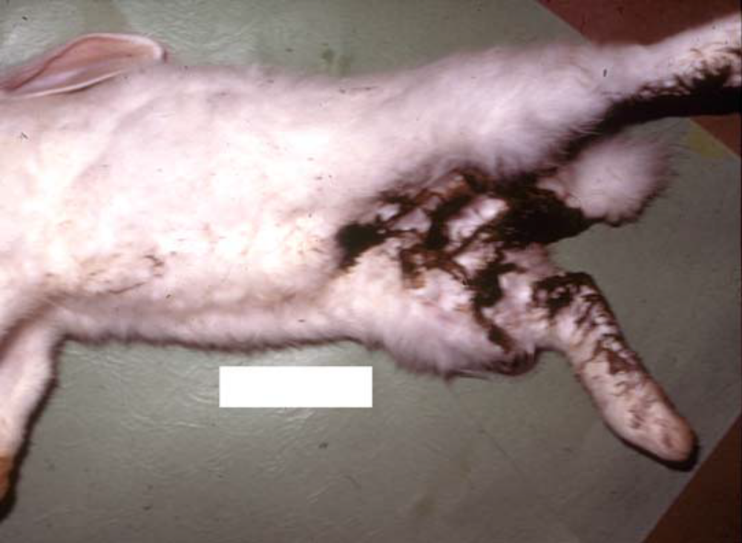
Diseases of Laboratory Animals Dr. P.O OKUMU

Slide 15
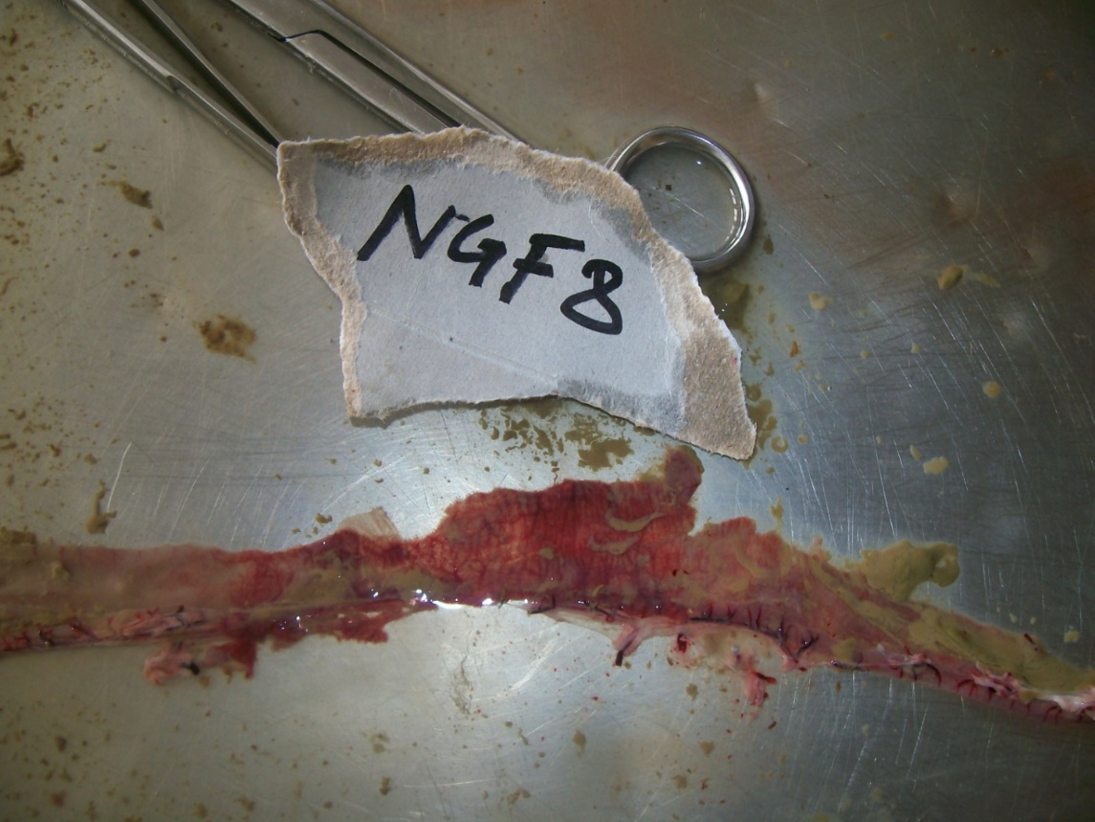
Intestinal coccidiosis
Diseases of Laboratory Animals Dr. P.O OKUMU

Slide 16
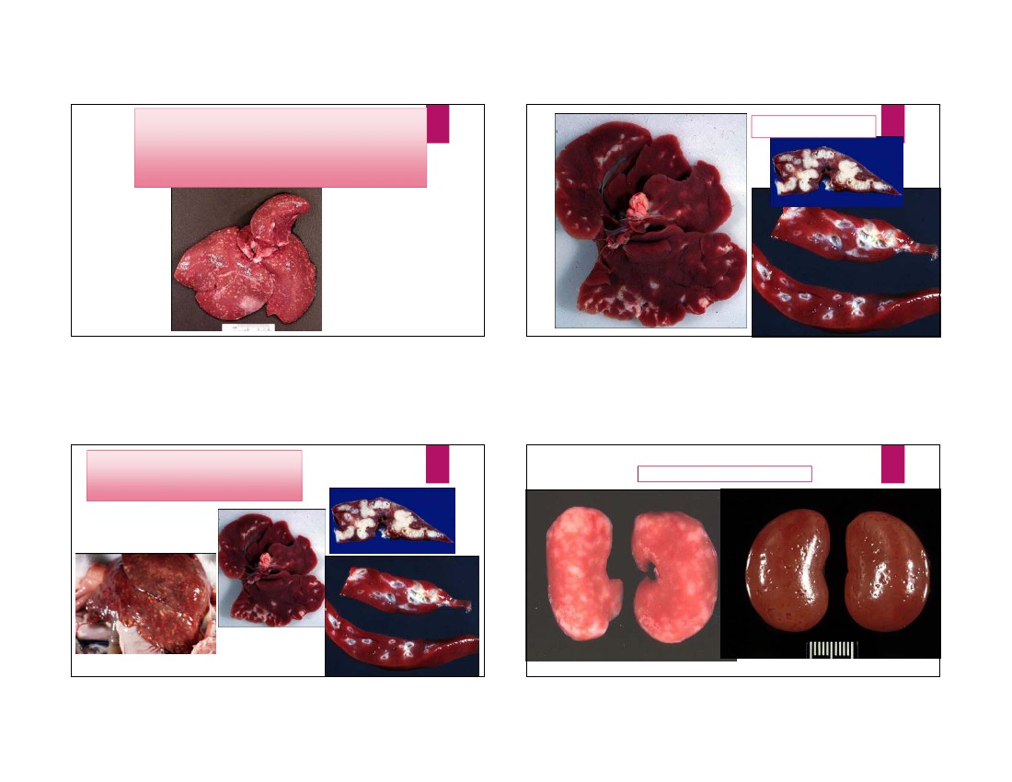
Hypelpasia of bile ducts
.

Slide 17
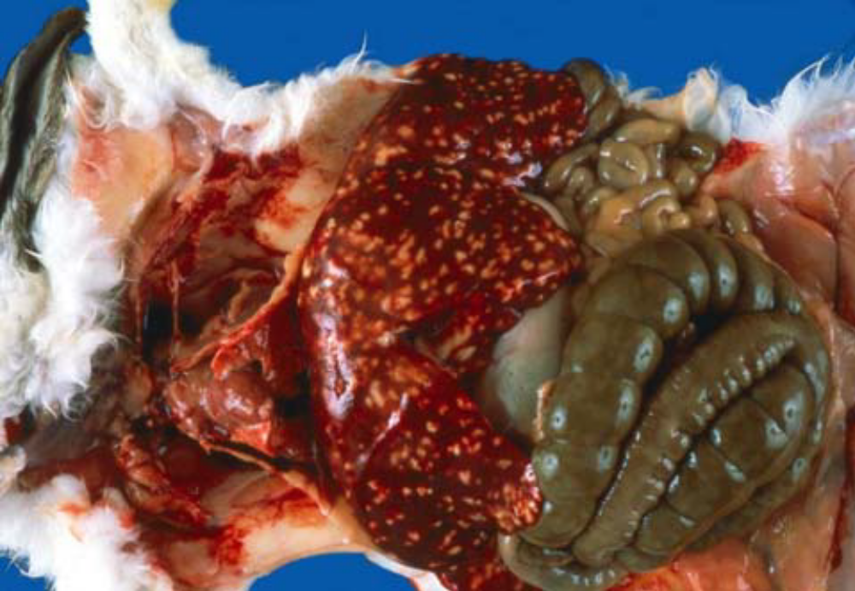
Diseases of Laboratory Animals Dr. P.O OKUMU

Slide 18
Diagnosis
symptoms and lesions •
Demonstration of coccidial parasites in stool (fecal smear, impression smear, macmaster techniques) or intestinal tissue sections (histopathology)

Slide 19
Avian coccidiosis
important diseases of poultry worldwide, and is characterized by enteritis.
Etiology
Nine species of Eimeria have been described from chickens, Of these seven are important
The seven species appear to be distributed throughout t he world. E. tenella is the commonest of the highly pathogenic species, whereas E. acervulina and E. maxima are the most prevalent

Slide 20
Transmission
Ingestion of viable sporulated oocysts is the only natural method of transmission.
Infected chickens may shed oocysts in the faeces fer several days er weeks.
The oocysts in faeces become infective through the process ef sporulation within 2 days.
Susceptible birds in the same fleck may ingest the oocysts.
The oocysts can be spread mechanically by different animals, insects, contaminated equipment, wild birds, and dust.
As already mentioned, oocysts are resistant to environmental extremes and to disinfectants .
Oocysts may survive fer many weeks in soil, but their survival in poultry litter is limited to' a few days because of the ammonia released by composting and the action of moulds and bacteria.
Threat of coccidiosis is less during hot dry weather and greater in cooler wet weather.

Slide 21
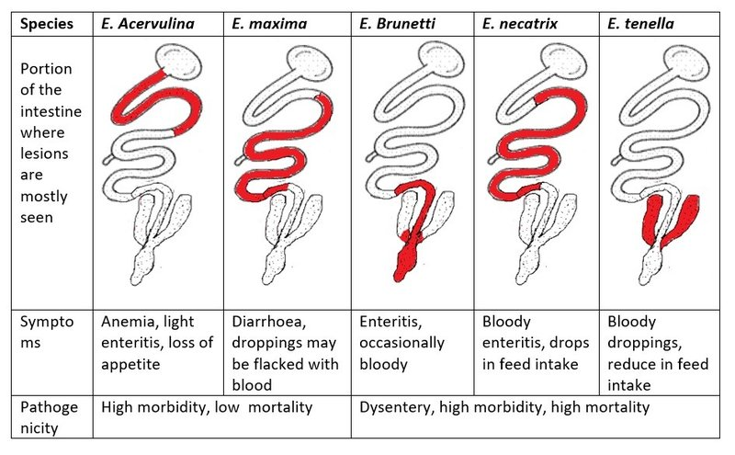
Lesions vary depending on the etology;

Slide 22
Lesions
Micro;
Microscopic examination of smears from intestinal lesions usually reveals numerous oocysts.
Histopathology of the small intestine reveals ovoid g ametocytes lining the mucosal cells on the villi.
In moderate to heavy infections, the tips of villi are broken off, leading to fusion of villi and thickening of the mucosa

Slide 23
Lesions
Gross
early stages mucosa of the lower small intestine is covered with tiny petechiae, Coagulative necrosis appears between 5-7 days of infection, and there is a caseous eroded surface over the entire mucosa. The coagulated blood and mucosa are seen in the droppings.
Oedematous swelling and thickening of the mucosa occur in severe infections
intestine may be ballooned,, lumen may be filled with blood and pieces of mucosal tissue

Slide 24
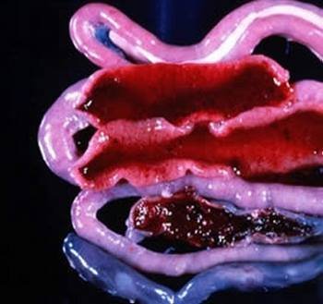
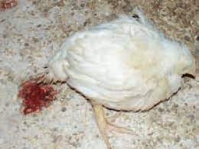
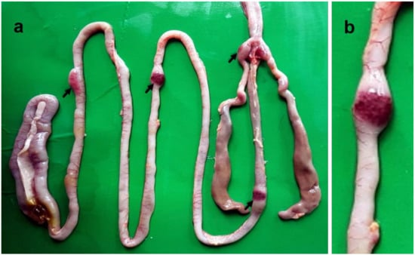

Slide 25
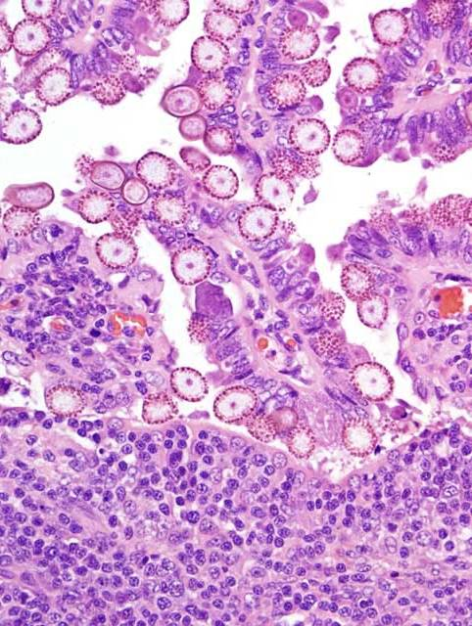

Slide 26
Other coccidia
the genera Besnoitia, Neospora, Toxoplasma and Sarcocystis of the Family Sarcocystidae also have an enteric asexual and sexual cycle in their definitive hosts
This tissue cycle has two stages:
1. An acute infection characterized by cellular necrosis,
2. A chronic infection characterized by dormant (not active), or latent collections of 0rganisms.
Following ingestion of oocysts and release of sporozoites, individual organisms termed"tachyzoites", invade beyond the gastrointestinal tract and enter into the cells 0f other 0rgans

Slide 27
Cryptosporidiosis
Disease of most domestic and wild animals, birds, and humans. It is caused by members of the genus Cryptosporidium.
Compared to Eimeria and Isospora. cryptosporidia are extremely s mall
The organisms are located intracellularly,
have typical coccidian life cycle of trophozoites, schizonts containing merozoites, macrogametocytes and microgametocytes, and oocysts
Infection through direct through sporulated oocysts which contain four sporozoites.
cryptosporidia are not host specific
parasitize intestinal epithelial cells, distal small intestine, but also of the caecum and colon and sometimes bile ducts, trachea, and bronchi

Slide 28
Lesions
Cryptosporidiosis is usually subclinical
Clinical disease is characterized by diarrhoea and is most common in young animals, or occurs in association with immunosuppressive disorders. The disease is of greatest importance in calves and lambs.
small intestine or colon, small basophilic 0rganisms a re found fixed deeply in microvilli of the intestinal cells.
Infected cells are slightly more eosinophilic than normal,
There may be villous atrophy and fusion, dilatation of crypts and infiltration of the lamina propria with lymphocytes and plasma cells and some neutrophils and eosinophils.

Slide 29
Diagnosis
Detection of Cryptosporidium oocysts in Ziehl-Neelsen-stained fecal smears
fecal flotation techniques,
ELISA, fluorescent-labeled antibodies, a rapid immunochromatographic test, and PCR.
Sheather’s flotation sedimentation staining is the most sensitive (83%) and specific (99%) of these techniques, with a relatively low cost per test.
Centrifuging a fecal sample in Sheather’s solution, aspirating the top layer and diluting the fluid in phosphate buffer saline, centrifuging, and placing the sediment on the slide and performing a modified Ziehl-Neelsen technique to look for cryptosporidial oocysts that appear as red spherical-to-ovoid structures (5–6 mm in diameter) by light microscopy about 10⁵–10⁷ oocysts/mL of feces is diagnostic

Slide 30
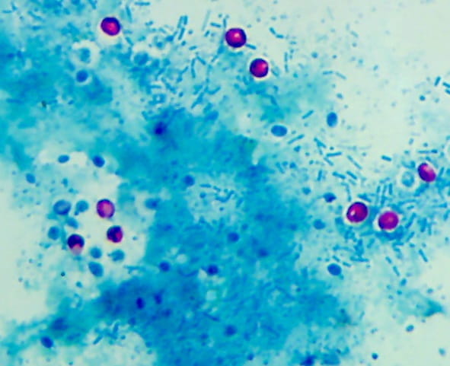
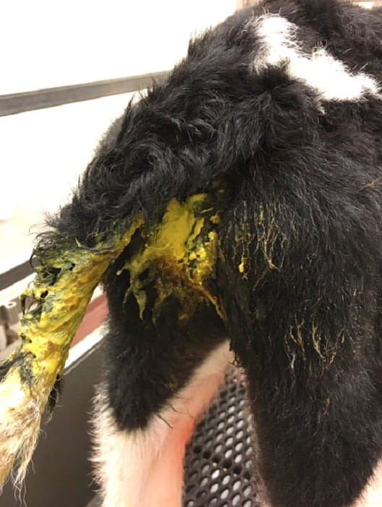
Diagnosis

Slide 31
Besnoitiosis
a chronic debilitating and sometimes fatal disease of cattle
Besnoitia besnoiti is the cause
has a two-host life cycle
Sexual reproduction occurs in the intestinal tract 0f the final host, Ieading to production of 0oocysts
Cats serve as the definitive (final) host for B. besnoiti.
Upon ingestion of oocysts by intermediate hosts (cattle, horses;), organisms attack many types of cells and produce small groups of tachyzoites
This acute infection can be severe and can cause death
Tachyzoites later attack fibroblasts and produce large cysts filled with bradyzoites.

Slide 32
Besnoitiosis
This is the infective stage for the final host
The cysts are large (up to 2 mm in diameter) and therefore visible to the unaided eye.
Painful swellings appear on the ventral aspects of the body, interfering with movement. The superficial lymph nodes are swollen, diarrhoea may occur, and pregnant cows may abort.
alopecia (loss of h air), severely thickened and wrinkled skin which is usually thrown into folds around the neck, shoulder and rump regions
Small, subcutaneous, seed-like lumps can be palpated.

Slide 33
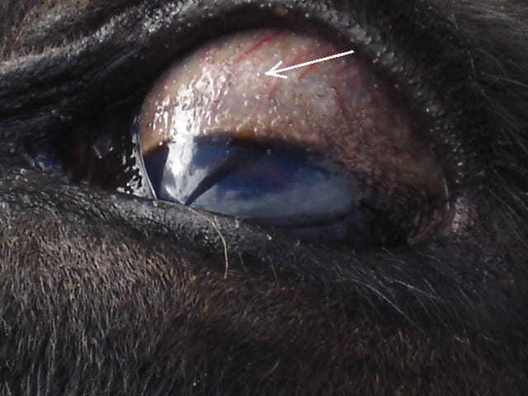
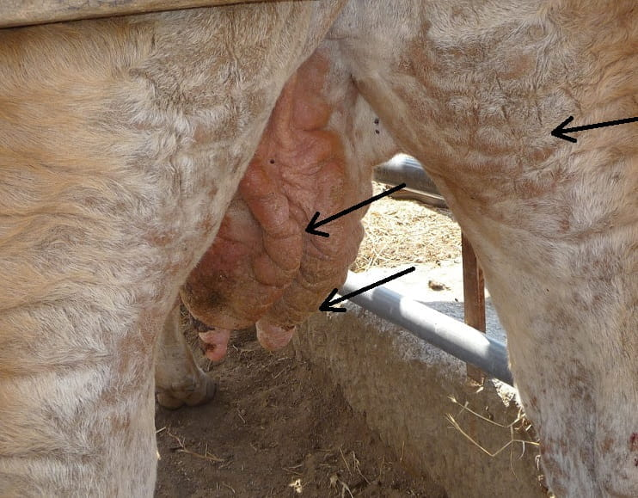
Cysts (arrow) are evident as pinpoint white to glistening papules on the scleral conjunctiva.

Slide 34
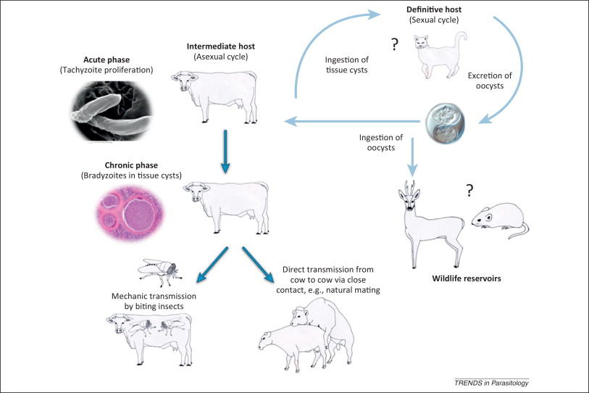
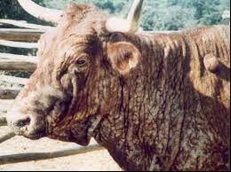

Slide 35
lesions
cutaneous lesions are seen grossly as thickened, rugose (wrinkled), hairless a reas of sk in, particularly on legs, thighs, and scrotum. T
Microscopic changes consist mainly of large spherical cysts deeper in the dermis, and are usually seen in the walls of small blood vessels.
Invasion of the scrotum, epididymis, and testis as well as upper gastrointestinal tract, is common. This may be accompanied by a severe granulomatous reaction.
Diagnosis
Demonstration of the organisms in tissue section

Slide 36
Toxoplasmosis
is a disease of all species, including man
Etiology Toxoplasma gondii,
The sexual cycle of Toxoplasma occurs in the cat which is the definitive (final) host
After eating infected meat or sporulated oocysts, the organism undergoes schizogony in the cat's intestine with a typical coccidian cycle
This leads to the production of oocysts
Cats shed millions of oocysts which are resistant to environmental influences.
The sporulated oocysts contain eight sporozoites and are capable of infecting a wide variety of intermediate hosts
Toxoplasmosis is characterised either by subclinical, acute or chronic infection characterized by formation of groups of tachyzoites in acute infection and cysts of bradyzoites

Slide 37
Transmissions
Most mammals and birds, as well as cats, serve as intermediate host
exposure to cat faeces, or materials contaminated by cat faeces (e.g., soil), or by the consumption of, or exposure to, infected tissues of intermediate hosts containing tachyzoites or bradyzoites
Congenital transmission may also occur in intermediate hosts during the acute phase by invasion of tachyzoites across the placenta. T
Toxoplasma have also been identified in milk and semen
Released sporozoites, ingested tachyzoites, or bradyzoites first multiply locally intracellularly in the intestine and lymph nodes.
These spread to other organs and tissues where they continue to reproduce. This leads either to tissue damage and clinical disease, or encyst (form cyst) as a collection of bradyzoites.

Slide 38
Pathogenesis
T. gondii is an intracellular parasite.
It attacks most organs with predilection for the reticulo-endothelial and central nervous systems.
Sporozoites from oocysts, or bradyzoites from tissue cysts, penetrate and multiply in the intestinal epithelium.
After invasion of a cell, the parasite multiplies, and eventually fills and destroys the cells.
Released toxoplasma reach other organs through the bloodstream.
The stage of parasitaemia begins about 5 days after initial infection, and lasts until the development 0 f immunity 2 -3 weeks after infection. At this stage the organism localizes in tissue cysts.

Slide 39
Lesions
The main manifestations are encephalitis when infection is congenital,
febrile exanthema (skin eruptions) with pneumonia and enterocolitis in acquired infections.
vast majority of infections occur without any clinical signs; and tissue cysts can be found in many animals and appear to cause no harm.
When immunity of the animal falls because of stress, disease, or immunosuppressive therapy, tissue cysts rupture, and large numbers of inflammatory cells invade surrounding tissue.
The characteristic granulomatous lesions are thought to be the result of a hypersensitivity reac

Slide 40
Genus: Babesia
Babesiosis
Synm; 'piroplasmosis', 'tick fever', and 'red water fever
Definition
Babesiosis is an infectious disease of animals caused by protozoan parasite and characterized by hemoglobinuria, anemia, petechiae and ecchymoses in serous membranes, icterus, pulmonary oedema and gastroenteritis.

Slide 41
Babesiosis
Etiology
Cattle- B. argentina, B. bigemina, B. bovis, B. divergens, B. major
Buffaloes- B. bigemina, B. bovis,
Sheep and goats- B. motasi, B. ovis
Horses- B. caballi, B. equi
Pig- B. trautmanni
Dogs- B. canis, B. gibsoni
Cats - B. felis

Slide 42
Pathogenesis
The disease is transmitted from sick to healthy animal through ticks following trans ovarian route.
The incubation period of disease is 5-10 days.
After infection, the parasite multiplies in peripheral blood and there is intra-vascular haemolysis leading to hemoglobinuria. The haemolysis results in prolonged anaemia, jaundice, and haemoglobinuria. Death is due to anaemic anoxia
The infected erythrocytes liberate some enzymes which interact with the components of blood and leads to increased erythrocyte fragility, hypertensive shock and disseminated intravascular coagulation.

Slide 43
Lesions
Macroscopic and microscopic features
• Anemia, icterus
• Hemoglobinuria
• Enlargement of spleen and liver
• Edema in lungs
• Petechiae and ecchymoses in kidneys, lungs, liver and spleen
• Congestion in gastrointestinal tract
• Presence of pear shaped Babesia organism in erythrocytes
• Hemorrhage in liver, kidneys, lungs and spleen • Hemosiderosis in spleen
• Necrosis of tubular epithelium in kidneys and presence of hyaline casts.

Slide 44
Gross
the blood to be thin and watery, and the plasma is red-tinged.
The subcutaneous, subserous, and intramuscular connective tissue is oedematous and yellow. Fat is similarly affected.
Icteric discoloration is clearly seen in all organs.
The spleen is usually enlarged 4-5 times the normal size, and its parenchyma is soft and d ark red.
T he splenic corpuscles are prominent.
Lymph nodes are usually enlarged.
The liver is enlarged, and the gallbladder distended with dark green bile.
The lungs are slightly oedematous, and the urinary bladder contains red-coloured urine.

Slide 45
Microscopic
The microscopic lesions are characteristic of severe haemolytic anaemia.
Haemoglobinuric nephrosis, centrilobular and paracentral necrosis of the liver, oedema, excessive fluid in the peritoneal, pericardial and pleural cavities, and serosal haemorrhages are usual findings.
Babesia can be demonstrated in large numbers in capillaries in brain. They are both free in the lumen and present in packed erythrocytes.
The organisms may be associated with small thrombi, foci of haemorrhage and necrosis.

Slide 46
Diagnosis
Clinically, jaundice with haemoglobinuria and fever are suggestive 0f babesiosis. T
The diagnosis is confirmed by identification of Babesia in blood smears.
The organisms can be identified by their morphology, and their stimulation of specific antibodies in the serum of infected animals. The antibodies can be detected by haemagglutination, agglutination, complement fixation, fluorescent antibody, and microplate enzyme immunoassay (EIA) tests.
Of all these tests, EIA is probably the most sensitive
DNA probes are also being used, and can detect specific parasitaemias at very low levels of infection.

Slide 47
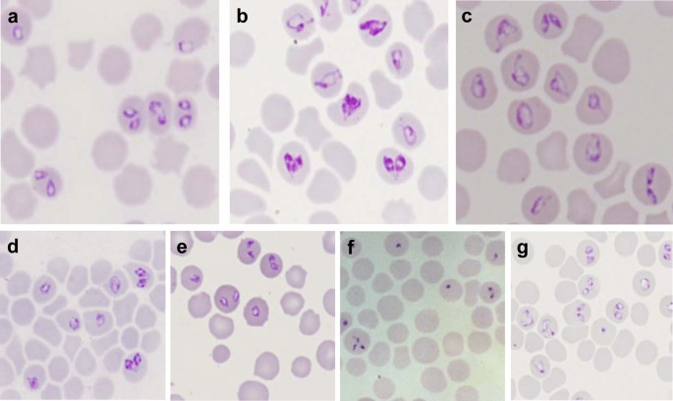
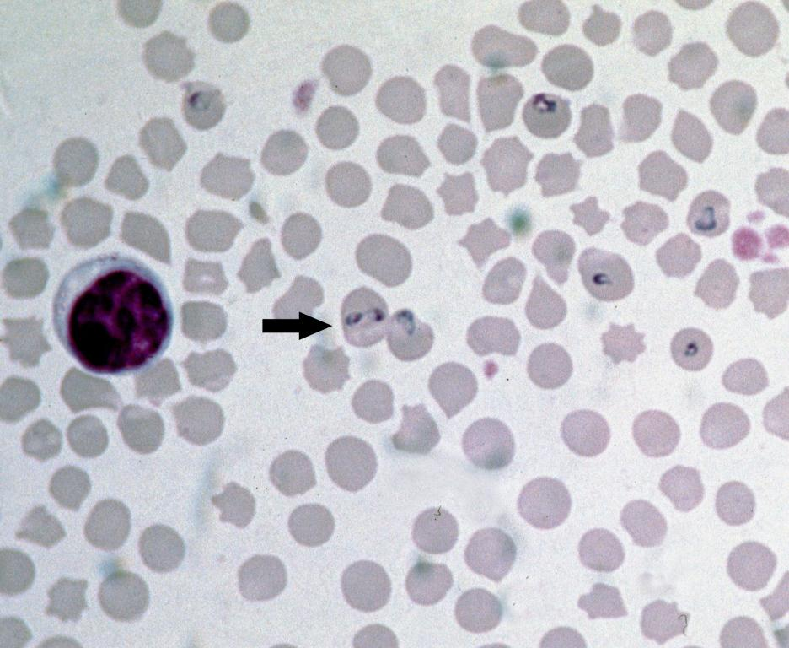
Babesia in smears

Slide 48
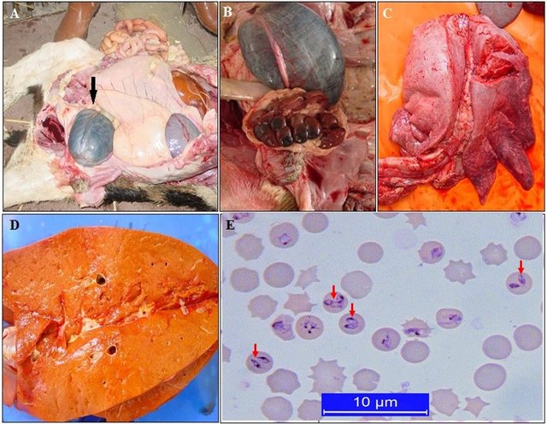
Post-mortem findings of bovine babesiosis caused by Babesia bigemina. Enlarged urinary bladder containing dark-colored urine (A), kidney degeneration (B), lung edema (C), jaundice of the liver (D), intra-erythrocytic merozoites on a Giemsa-stained blood smear (E) [3

Slide 49
Theileriasis/East Coast fever,
Theileriasis is a tick-borne protozoan disease caused by Theileria sp. in cattle, buffaloes, sheep and goats, as well as in wild and captive animals.
Disease is characterized by fever and Iymphoproliferative disorders which may be associated with leukopaenia and/or anaemia
Transmission ; ticks

Slide 50
Important Pathogenic Theileria
T.annulata (T. dispar)- cattle, buffaloes-tropical theileriasis
T. hirei –shoats
T.lawrencei - cattle, buffaloes –”Buffalo disease"
T.mutans - cattle, deers
T. ovis - shoats
T.parva- cattle, buffaloes

Slide 51
Pathogenesis
Sporozoites (e.g., of T. parva) a re introduced into bovine host by the vector tick in its saliva when it is feeding.
Ticks must feed for 2-4 days before the sporozoites in their salivary glands mature and become infective to cattle.
The sporozoites then enter lymphocytes and develop into schizonts in the lymph node draining the area of attachment of the tick, usually the parotid node.
Infected lymphocytes are transformed to lymphoblasts, which divide along with the schizonts so that each daughter cell is also infected.
Finally, infected lymphocytes are disseminated throughout the lymphoid system.

Slide 52
Pathogenesis
Later, some schizonts, differentiate into merozoites, are released from the lymphoblasts, and they invade erythrocytes.
In the red blood cells, the parasites transform to become piroplasms which are infective to the tick w hen it feeds.
The ingested parasite undergoes several developmental stages a nd eventually forms sporozoites in the tick salivary glands, thus completing the cycle.
The main pathological lesion is the damage caused to the lymphoid system by rapidly multiplying schizonts, and the a associated proliferation 0 f lymphocytes in parenchymatous organs

Slide 53
lesion
Lymph nodes are 0edematous and may show haemorrhage.
Spleen may be normal, large, or small.
Usually, pulmonary oedema and emphysema, subcutaneous and intramuscular oedema, and excessive pericardial and pleural fluids are present.
The liver is usually enlarged, yellowish, and mottled.
White foci of various sizes may be seen in the renal cortex.
The meninges may be congested and focal haemorrhages are present in the brain.

Slide 54
lesions
The main microscopic lesion is proliferation of lymphocytic cells in lymph nodes, spleen, Peyer's patches, liver, kidneys, and elsewhere.
Blood vessels, including cerebral vessels, are filled with parasitized lymphocytes. These obstruct the blood flow and cause focal infarction.
Koch's bodies may be found in tissue sections of many organs.

Slide 55
Diagnosis
Demonstration 0 f the 0 organisms in erythrocytes and in lymphocytes (Koch's bodies).
Koch's bodies (i.e., schizonts) are seen only sometimes in circulating lymphocytes, but mostly in biopsy smears of enlarged lymph nodes stained with Giemsa.
Piroplasms are seen easily in erythrocytes as round,oval,ring,rod and comma form from day 16 after tick attachment, and they increase in number until death.
Various tests for antibodies have been used with success. These i nelude complement fixation, indirect haemagglutination, immunofluorescence, and ELISA

Slide 56
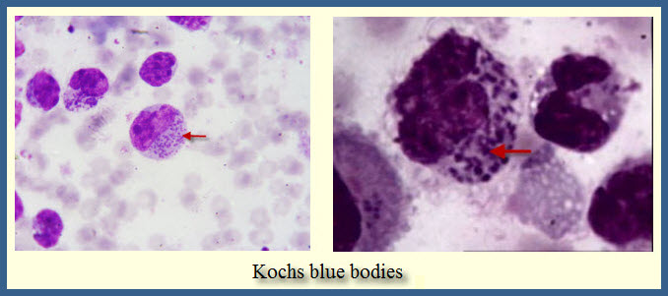
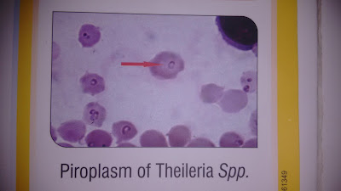

Slide 57
Genus: Encephalitozoon
Encephalitozoonosis
Etiology; Encephalitozoon cuniculi is best known as a cause of encephalitis and nephritis in rabbits, but also affects dogs, cats, monkeys, wild carnivores, and humans.
Infection is usually subclinical, even in rabbits. The infection is acquired by ingestion 0 f spores excreted in urine. Ingestion of infected tissues containing spores is another source of infection

Slide 58
Encephalitozoonosis (Nosematosis)
Etiology: Encephalitozoon cuniculi, Gram positive, obligate intracellular microsporidian
Affects mice, rabbits and rats
Transmission: Ingestion of contaminated urine, Transplacental infection, inhalation of spores
Pathogenesis: The spores are spread hematogenously via macrophages,
Spore parasitize vascular endothelium, in the brain and kidney, liver, lungs, adrenal glands, spleen and other highly vascular organs
.
Diseases of Laboratory Animals Dr. P.O OKUMU

Slide 59
Pathogenesis……… contd Encephalitozoonosis (Nosematosis)
Spores are released and infect adjacent cells
Gross lesions:
focal, irregular, depressed, pale areas, 2-4 mm in diameter on the renal cortical surface
Histo:
Granulomatous to chronic interstitial nephritis with tubular ectasia and spores within tubular epithelial cells, macrophages,
Central nervous system: focal nonsuppurative, granulomatous meningoencephalitis with perivascular lymphocytic cuffing
Diseases of Laboratory Animals Dr. P.O OKUMU

Slide 60
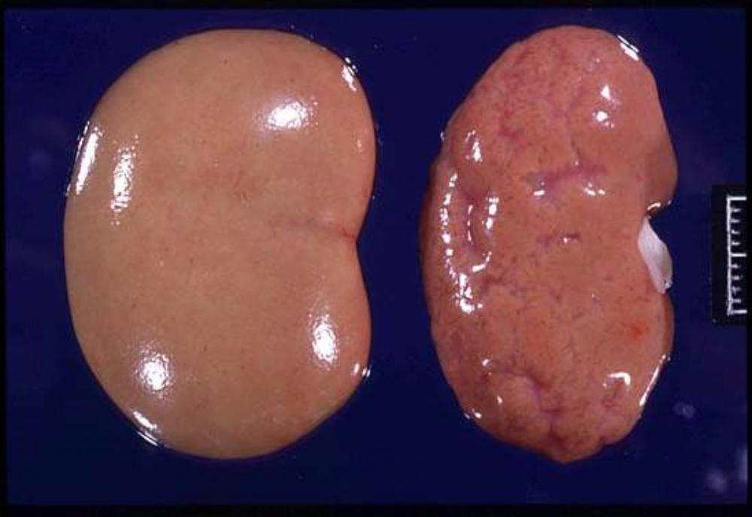
Diseases of Laboratory Animals Dr. P.O OKUMU

Slide 61
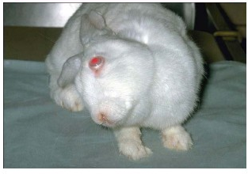
Torticollis
Diseases of Laboratory Animals Dr. P.O OKUMU

Slide 62
Histomoniasis
Also known as "blackhead", "infectious enterohepatitis", histoplasmosis
histoplasmosis is a disease of caeca and liver caused by the protozoan parasite Histomonas meleagridis
primarily a disease of turkeys. occurs in chickens but in a milder form
The disease is characterized by necrotic foci in the liver and ulceration of the caeca.

Slide 63
Transmission
The existence of H. meleagridis is closely associated with caecal nematode Heterakis gallinarum and several species of earthworms common in the soil of poultry premises.
Earthworms serve as transport hosts in which h Heterakis eggs hatch, and the young worms survive in tissues in an infective stage.
The earthworms thus serve as a means for collection and concentration of heterakid eggs from the poultry premises en

Slide 64
Pathogenesis
Lesions occur in the caeca and then in the liver.
caecal walls become thickened and hyperaemic (Le., typhlitis, inflammation 0 f caeca).
Serous and haemorrhagic exudate from the mucosa fills the lumen of caeca and distends the walls with a caseous or cheesy core.
Ulceration of the caecal wall may lead to perforation of the organ and cause generalized peritonitis.
Liver lesions in turkeys appear as circular depressed areas of necrosis up to 1 cm in diameter, and are surrounded by a raised ring.

Slide 65
Diagnosis
Diagnosis can usually be made from the characteristic gross lesions which remain clearly visible long a fter death.
I f confirmation is required, stained sections from the periphery of liver lesions will reveal rounded up organisms.
Identification of living organisms in wet preparations from cecal lesions is a little difficult. It requires fresh material and a heated microscope stage.

Slide 66
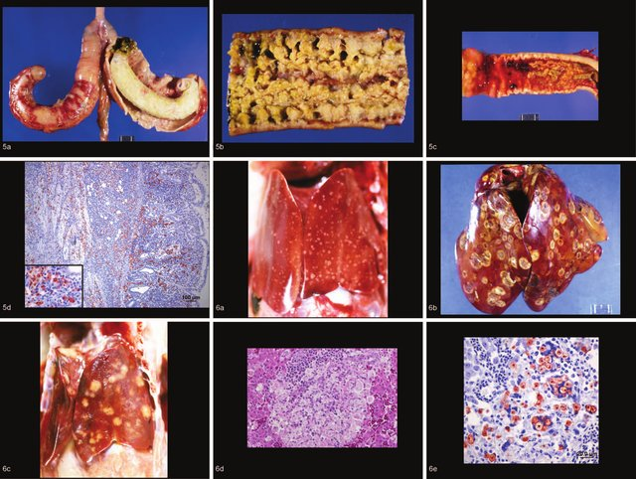

Slide 67
Trypanosomiasis
Trypanosomiasis is a very serious disease of humans and animals.
The disease trypanosomiasis is divided into two major forms:
1. A merican trypanosomiasis caused by Trypanosoma cruzi, and
2. African trypanosomiasis caused by the other pathogenic trypanosomes.

Slide 68
Etiology
Species | Definitive host | intermediate hosts (vectors) | Geographic distribution | Disease
T. brucei | Man, domestic and wild mammals,except goats | Tsetse fly | africa | Nagana
T. caprae | horse, cattle , sheep, | Tsetse fly | tanzania, Malawi | Trypanosmomiasis
T. congolense | horse, cattle , sheep, dog, donkey | Tsetse fly | tropical africa | Trypanosmomiasis
T. equiperdum | Horse, ass | Transmitted by coitus | world wide | dourine
T. cruzi | Man, dog, cat, armadillo, opossum | "Kissing bug"(Triatoma sp.) | south America | American trypanosomiasis/chagas disease
T. evansi | Horse, mule, ass, cattle, buffalo | Horse flies (Tabanidae and Stomoxys | Africa, Asia, South America Far East | Surra
T. gambiense | Man, antelope | Tsetse fly | Tropical Africa | Chronic "sleeping sickness"
T. rhodesiense | Man, antelope | Tsetse fly | East Africa | Acute "sleeping sickness"
T. simiae | Monkey, pig, horse, sheep | Tsetse fly | east Africa | Trypanosmomiasis
T. vivax | Cattle, sheep, horse, goat, camel | Tsetse fly | Central and South America, Mauritius and Africa | Souma
1. Transmission – by arthropods (i.e tsetse fly, Tabanidae and Stomoxys), and coitus
2. Definite cyclic development occurs in the body of true invertebrate hosts
3. In these hosts, trypanosomes multiply in the digestive tract, migrate as infective forms to the salivary glands and are injected into the mammalian host with the vector's saliva at the time of the bite.

Slide 69
Pathogenesis
When transmitted through vector saliva, trypanosomes are referred to as salivarian, and when through arthropod faeces as stercorarian.
In mammalian host, trypanosomes of A frican trypanosomiasis (salivarian) rapidly multiply by binary fission (as trypanomastigotes) within the bloodstream, leading to parasitaemia.
Parasitaemia remains mostly unaffected and is not diminished by the host's immune response.
This is because of the parasite's unique ability to undergo almost endless anti genic variations through changes in surface glycoproteins

Slide 70
Pathogenesis
Because of their variability, these surface antigens are called variant or variable surface glycoproteins (VSGs)
Trypanosomes may also enter the interstitial space and multiply there.
Continued stimulation of the immune system by VSGs explains the reticuloendothelial, lymphocytic, and plasmacytic (of plasma cells) hyperplasia seen in the spleen and lymph nodes
Glomerulonephritis and vasculitis, result from the continuous immune response and the formation of antigen-antibody complexes

Slide 71
Anaemia is a common finding. It is in part haemolytic and in part due to erythrophagocytosis.
Altered cells, being regarded as foreign, are either lysed by antibody and haemolytic complement, or are phagocytosed by mononuclear phagocytes

Slide 72
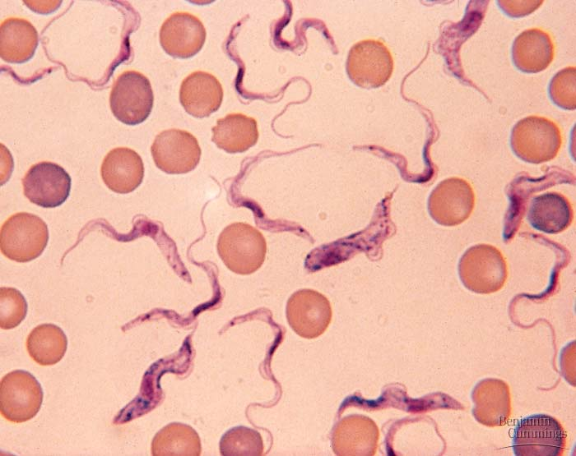
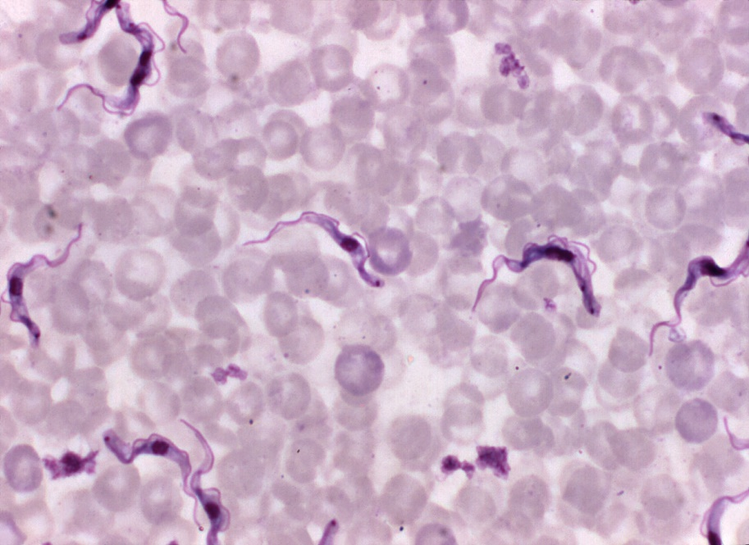
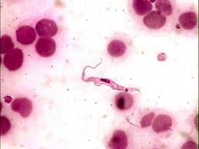

Slide 73
Surra
Surra is an acute, subacute, or chronic disease of mainly horses, mules, asses and camels, but also occurs in cattle, buffaloes. dogs, deer, Bengal tiger and elephants.
The disease is characterized by fever, progressi ve emaciation, anaemia, subcutaneous 0edema, nervous signs and death.
It is regarded as the most important health problem in camels
Trypanosoma evansi (syn. T. equinum).
Wild ruminants can act as reservoirs. T. evansi is transmitted mechanically by the bite of horse flies (Tabanus, Stomoxys).

Slide 74
Lesions
oedema of dependent parts of the body (limbs, lower abdomen and thorax).
gradual e maciation in spite 0f good a ppetite. nasal and ocular discharge, progressive anaemia, delirium and convulsion.
Grossly. the carcass is emaciated and pale and may be jaundiced. There may be patchy alopecia a nd petechiae a nd ecchymoses 0 f visible mucosae
Diagnosis ; Trypanosomes a re readily seen in blood smears from animals in acute form
Chronic form-repeated sampling examination of buffy coat
Inoculate in dogs and rodents (very susceptible)

Slide 75
'African trypanosomiasis'
Syn; Nagana, "tsetse fly" disease, 'African trypanosomiasis’
Etiology; Trypanosoma brucei, T. congolense, and T. vivax
Pathogenesis
T. vivax usually multiplies in blood and is even disseminated throughout the cardiovascular system,
T. congolense tends to be aggregated in small blood vessels and capillaries of t he heart, b rain and skeletal muscles from where a small proportion of trypanosomes enter the blood circulation.
T. brucei and rarely T. vivax, have the ability to pass out of the capillaries into the interstitial tissues and serous fluids of body cavities where they continue to multiply.
T. vivax and T. congolense exert their effect mainly by causing severe anaemia and mild to moderate organ damage.

Slide 76
Lesions
The postmortem lesions, like the clinical signs, are not pathognomonic.
The carcass shows Severe emaciation, with 0 edematous change in all fatty tissues.
The lymph nodes are swollen, oedematous, sometimes with haemorrhage in the medulla.
Liver is enlarged and congested. Spleen is either enlarged, normal, or a trophic.
Haemorrhages are common, particularly in the subendocardial and epicardial locations.
Pericardial fluid may be excessive.
Congestion and haemorrhage may be prominent in the gastrointestinal tract.
Diagnosis – discussed

